Slide 1
3D Visual of radiation source using area dose
Akash Awasthi
Madhu vamsi
Guided by
Vibhuti Duggal

Slide 2
Problem Statement
Develop code on GPU/CPU
Solve reverse Boltzmann Transport Equations (BTE) in offline mode.
Using given datasets (X,Y,Z, Dose equation)for given area.
Other Known quantities are values of E, K and Ψ.
3D visualization of radiation source in that area.

Slide 3
Introduction
Boltzmann transport equation describes
Macroscopic behaviour of the photons
Interaction among the photons is negligible .
Simplified version of LBTE for source localization when geometry and type(energy and flux) is known.

Slide 4

Introduction
The linear BTE to calculate the dose at any given target point is
D(x,y,z) is the dose in Mev/mass
E is the energy in Mev.
Ψ is the photon fluence in photon/cm2.
Ω is direction of photon beam in steradian
σ is macroscopic energy deposition cross section in Mev/cm
ρ is material density in gm/cm3

Slide 5
Solution
Proposed solution
Solve reverse of LBTE using MATLAB
Find position and geometry of the source in the free space.
Project Scope
Point source located at free space
Three-point source located at the corner of the cube
Line source emitting constant radiation

Slide 6
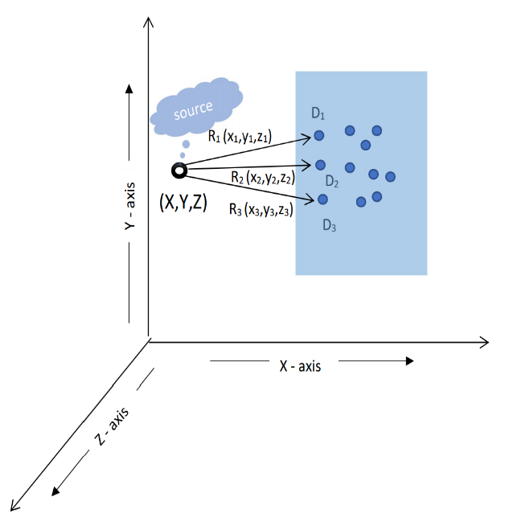
Point source located at free space
A point source S(x,y,z) located in free space at (x, y, z).
Three targets T1, T2, T3 at (x1, y1, z1), (x2, y2, z2), (x3, y3, z3) as defined in fig.
Dose at the point T1,T2,T3 is D1,D2,D3 respectively ,calculated using forward LBTE

Slide 7
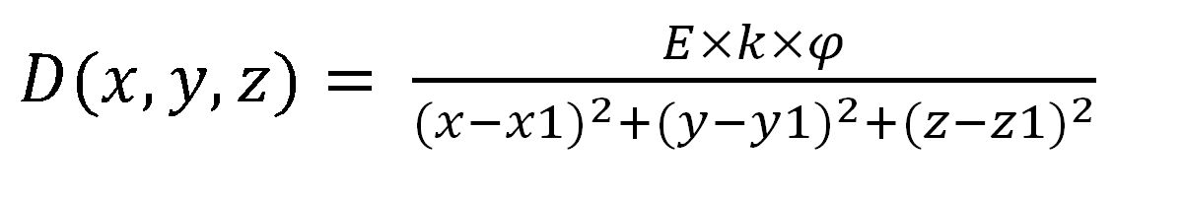
Forward Calculation
Equation used to calculate Dose at target point is defined as Forward calculation.
Simple LBTE to calculate dose at target point T1 due to source S is as follows

Slide 8
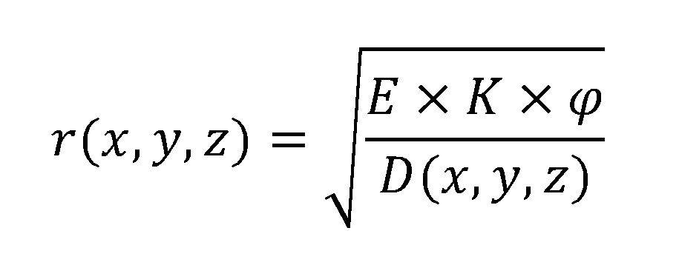
Inverse Calculation
Calculate distance r(x, y, z)
Between target point and source point using given dose D(x, y, z).
Distance between target point T and point source can be calculated by the inverse LBTE.

Slide 9
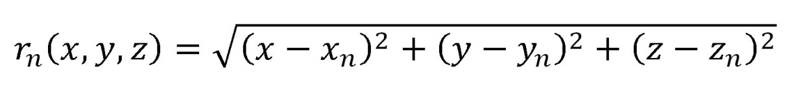
Distance between n^{th} target point Tn and source point S(x,y,z) is r_{n}(xn, yn, zn) .
Three target points T1,T2,T3.
Solving eq for n=1to 3 .
Get the value of x, y, z which is the coordinates of source S .

Slide 10
Code for detecting the single source point
% Coordinates of target points and dose equation are already known
% Calculate the dose by the given dose equation
%.......Inverse part.......
% Calculate the centers
centers= [x, y, z];
% Calculate inverse radius
for mn=1: n
fradius(mn)= (E*flux*constant) /dose(mn);
end
dist=fradius
% With centers draw spheres with radius ‘dist’
% The common region will be the source location

Slide 11
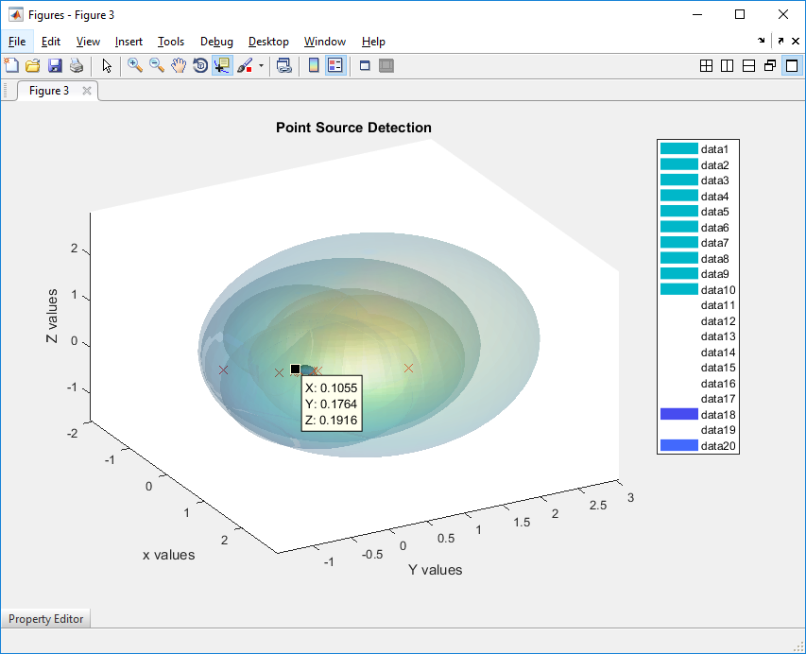
Results:
Visualization of the point
Intersection of all the spheres
Source at point (0,0,0).
Got common region of all spheres at point (0,0,0).
Same output by using mathematical analysis and visualization

Slide 12
Multiple point sources located at the corners of the cubes.
Assume three-point sources S1,S2,S3 .
Located at three corners of the unit cube.
There are target points located in the free space.

Slide 13
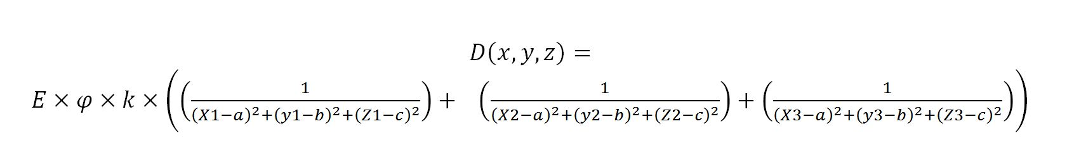
Forward calculations
Equation to calculate Dose at target point T(a, b, c).
It is the sum of three doses due to S1, S2, S3 at T.

Slide 14
Inverse calculation
Calculate the source point using dose D(x, y, z).
Nine target points are known.
Three unknown source points Sn (xn, yn, zn) where n=1to 3.
Table defines r and D (x, y, z).
Source | Target | Distance (r) | Dose D (x, y, z) | Total Dose
S1 | T1 | R_{T1} | D_{t1} | D_{t1’}
S2 | T1 | R_{T1} | D_{t1}
S3 | T1 | R_{T1} | D_{t1}
S1 | T2 | R_{T2} | D_{t2} | D_{t2’}
S2 | T2 | R_{T2} | D_{t2}
S3 | T2 | R_{T2} | D_{t2}
S1 | T3 | R_{T3} | D_{t3} | D_{t3’}
S2 | T3 | R_{T3} | D_{t3}
S3 | T3 | R_{T3} | D_{t3}
S1 | T4 | R_{T4} | D_{t4} | D_{t4’}
S2 | T4 | R_{T4} | D_{t4}
S3 | T4 | R_{T4} | D_{t4}
S1 | T5 | R_{T5} | D_{t5} | D_{t5’}
S2 | T5 | R_{T5} | D_{t5}
S3 | T5 | R_{T5} | D_{t5}
S1 | T6 | R_{T6} | D_{t6} | D_{t6’}
S2 | T6 | R_{T6} | D_{t6}
S3 | T6 | R_{T6} | D_{t6}
S1 | T7 | R_{T7} | D_{t7} | D_{t7’}
S2 | T7 | R_{T7} | D_{t7}
S3 | T7 | R_{T7} | D_{t7}
S1 | T8 | R_{T8} | D_{t8} | D_{t8’}
S2 | T8 | R_{T8} | D_{t8}
S3 | T8 | R_{T8} | D_{t8}
S1 | T9 | R_{T9} | D_{t9} | D_{t9’}
S2 | T9 | R_{t9} | D_{t9}
S3 | T9 | R_{t9} | D_{t9}

Slide 15
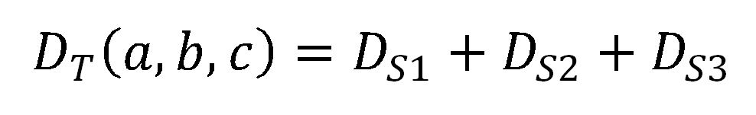
Dose at T1(a1, b1, c1) is calculated as:
Calculate coordinate of S1,S2,S3 by solving equation given below for n=1 to 9:

Slide 16
Code for detecting three source points
%The dose at a given target point from all three source locations are calculated from given dose equation.
% (D=d1+d2+...dn) for n source points.
%Find the summation of radius.
for loop=1: n
R(loop)=dose(loop) /(E*flux*constant);
end
%Find the radius equations from each source point.
for i=1: n
radius1sqr(i)=((x1-x(i)) ^2+(y1-y(i)) ^2+(z1-z(i)) ^2);
radius2sqr(i)=((x2-x(i)) ^2+(y2-y(i)) ^2+(z2-z(i)) ^2);
radius3sqr(i)=((x3-x(i)) ^2+(y3-y(i)) ^2+(z3-z(i)) ^2);
end
%Find the equations of these lines.
for mn=1: n
equation(mn)= ((1 /radius1sqr(mn)) +(1 /radius2sqr(mn))+(1/radius3sqr(mn)))-R(mn);
end
%Solve these equations to find the source points.
solution=vpasolve(eq(1),eq(2),eq(3),eq(4),eq(5),eq(6),eq(7),eq(8),eq(9));
%Visualize these solutions using spheres with centers as target points and radius as distance between source point and target point.

Slide 17
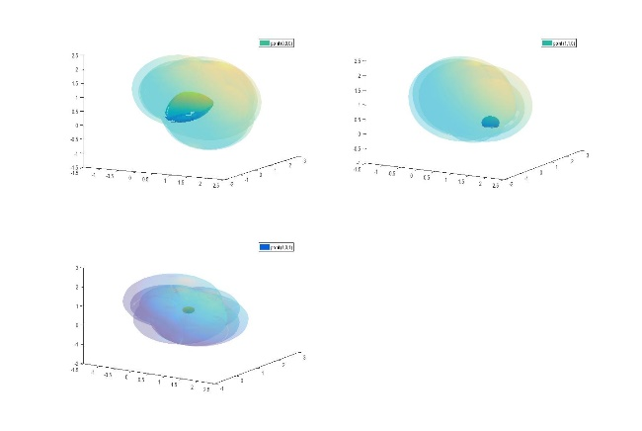
Results (for source located at three points)
Visualization of the point
Intersection of all the spheres.
Assumed sources at point S1(1,1,0), S2(0, 0 ,0 ) , S3(1,0,1).
We got common region of all spheres at points (1,1,0), (0,0,0),(1,0,1).
Same output by using mathematical analysis and visualization

Slide 18
Line source parallel to the axis and emitting the radiation.
Assumptions:
Line source located parallel to axes
Emitting constant radiation.

Slide 19
Forward Calculation
The equation used to calculate Dose at target point is defined as Forward calculation.
Simple LBTE to calculate dose at target point T1 due to source S is as follows

Slide 20
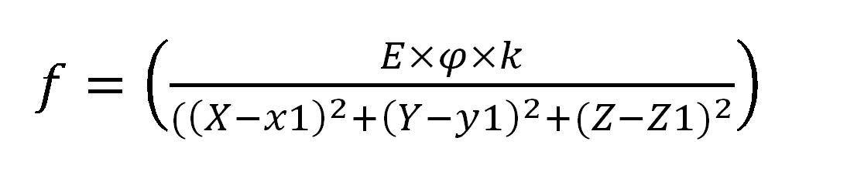
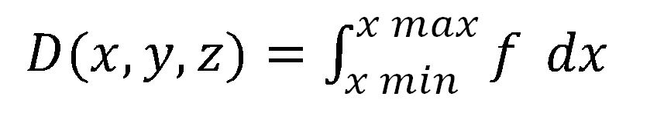
Forward calculations
Calculate the Dose at the target point (x1,y1,z1) due to line source of length l

Slide 21
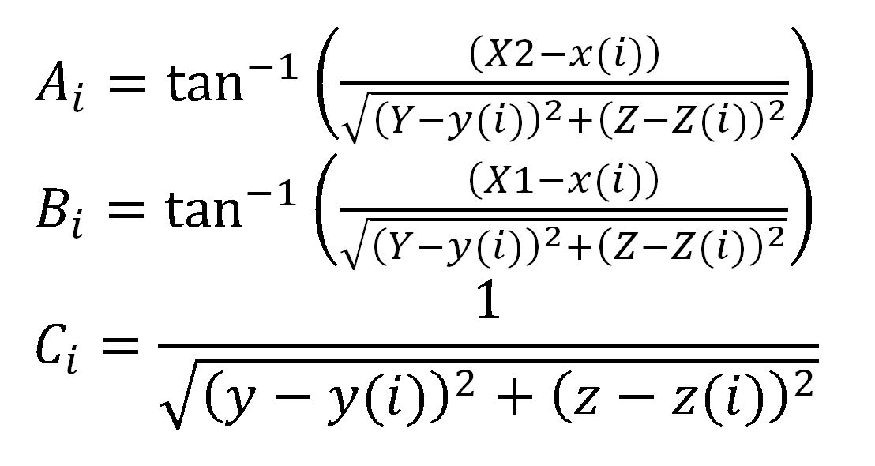
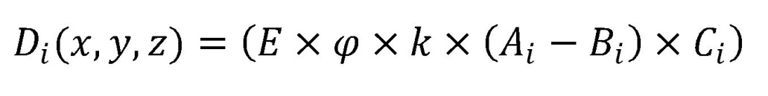
Inverse Calculations
Assume four target points T1,T2,T3,T4.
A line source of length l and placed along x-axis .
From x=xmin to x=xmax.
Solve four equations (i=1 to 4) with four unknowns.
Gives the position of line source.

Slide 22
Code 3 for solving equations to get the line source
%The dose is being calculated from the given dose equation .
%In inverse part find the equations.
for i=1: n
A=(X2-x(i))/sqrt((Y-y(i))^2+(Z-z(i))^2)
B=(X1-x(i))/sqrt((Y-y(i))^2+(Z-z(i))^2)
C=100*100*30
D=1/sqrt((Y-y(i))^2+(Z-z(i))^2)
d(i)=((atan(A)-atan(B))*C*D)-dose(i)
end
%Solve these equations to get the location of the source .
solution=vpasolve(d(1),d(2),d(3),d(4))
%Visualize these solutions using spheres with centers as target points and radius as distance between source point and target point.

Slide 23
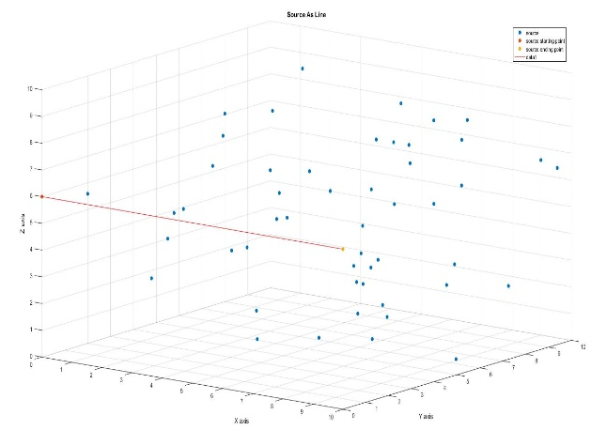
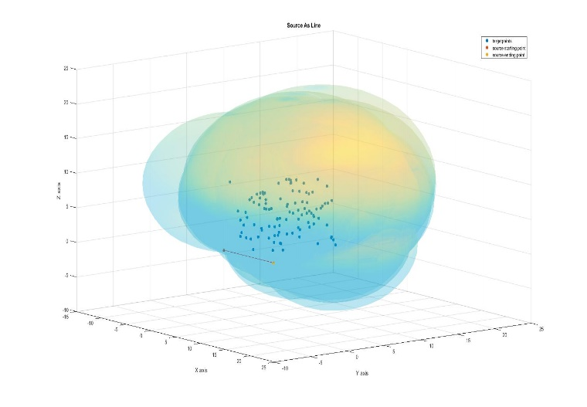
Results
Visualization of line source of length 10 cm between xmin=1 to xmax=10 and target points in free space .
Fig(6) Analytically Calculated
Fig(7) Visualization of Calculated source

Slide 24
Real Time Applications
Occupational workers carry wearable sensors for radiation dose data logging, datasets are generated due to movement of workers.
Find missing source / unwanted resources
Remove unwanted sources
Confirm there is a leakage in pumps
Radiation protection program to take corrective measures

Slide 25
References
Akpochafor M. O., Aweda M. A., Durosinmi-Etti F.A., Adeneye S.O., Omojola AD, “Simulation of the Linear Boltzmann Transport Equation in Modelling Of Photon Beam Data”, IOSR Journal of Applied Physics (IOSR-JAP) e-ISSN: 2278-4861.Volume 5, Issue 6 (Jan. 2014), PP 72-86
EEVA BOMAN , “Radiotherapy Forward and Inverse Problem Applying Boltzmann Transport Equation”, KUOPIO UNIVERSITY PUBLICATIONS C. NATURAL AND ENVIRONMENTAL SCIENCES 204.

